Slide 1

Showcase presentation template
Please do not edit this file. Please make a copy of this file to customize for your own presentation
Guidance for Team Leads.
Final deck is due 1 business days prior to event.
3 minutes have been allotted for your presentation this includes your 1-min demo.
Please note, there will not be any Q&A.
Pre-Event
Utilize colors and existing slide layouts, no modifications please.
to ensure a successful Showcase, please practice your presentation so you will end on time.
The showcase final deck will be shared with presenters the day before the event.
Event
Plan to join 15 minutes prior to event start time.
You will be responsible for running the deck and advance all slides.
Reminders
You must utilize Azure in your solution
Notes:
Korrie
updated 7/21

Slide 2

Student Ambassador Projects
Ambassador Projects Template Deck
Notes:
Korrie

Slide 3
Alchemist Crew Chef’s Whispers: Personalized Recipe Recommendation (Ai and Application Development)
Nouran Hassan Ahmed Mohamed
Anas Abduelhaag Durraiz Ali
Ayodhya Janodani
Notes:
Korrie

Slide 4
The Opportunity : Concept and Motivation
The Problem & Industry Trends
Consumers demand personalized food experiences, but most recipe platforms are generic.
1.3 billion tons of food are wasted annually due to poor meal planning.
People struggle with ingredient management.
The Opportunity: AI-Powered Personalization
Traditional platforms fail to offer real-time, tailored suggestions.
Our AI-driven system learns available ingredients, number of servings to recommend the perfect meal.
Big companies can integrate this technology to reduce waste, enhance engagement, and boost sales.
Notes:
Korrie
updated 7/21

Slide 5

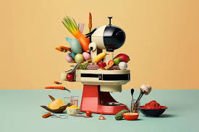
The Opportunity : Concept and Motivation
The Vision: Smarter, Sustainable Cooking
Empowering users with AI-driven meal planning for healthier, hassle-free cooking.
Minimizing food waste by recommending meals based on what users already have.
Driving industry innovation by integrating AI into everyday kitchen experiences.
Notes:
Korrie
updated 7/21

Slide 6
Solution
Why We Built This Solution
Need for Personalization: Consumers are frustrated with generic recipe suggestions and face challenges with food waste and decision fatigue. We created a simple, AI-driven solution for personalized meal recommendations based on available ingredients.
How We Address Customer Pain Points
Simple & Efficient: Users sign in, input ingredients, and receive instant, personalized recipes.
Key Benefits: Saves time, reduces food waste, and helps users make meals based on what they already have.
Customer Examples
Busy Professionals: Get quick dinner ideas without the hassle of meal planning.
Eco-Friendly Families: Minimize food waste by using available ingredients efficiently.
Notes:
Korrie
updated 7/21

Slide 7
Solution
Where We Fit In
Food-Tech Space: We provide personalized, ingredient-based recipe suggestions, setting us apart from traditional recipe platforms.
Competitive Edge: We focus on delivering instant, tailored meal ideas instead of generic recommendations.
What Sets Us Apart
Real-Time Personalization: Unlike competitors, we use user-provided ingredients for immediate, custom meal suggestions.
Tech Stack: Built with Azure Functions, Azure SQL, React, and Node.js, ensuring a seamless, scalable solution.
Customer-Focused: We provide actionable recipes, setting us apart from platforms that only offer broad recipe lists.
Notes:
Korrie
updated 7/21

Slide 8
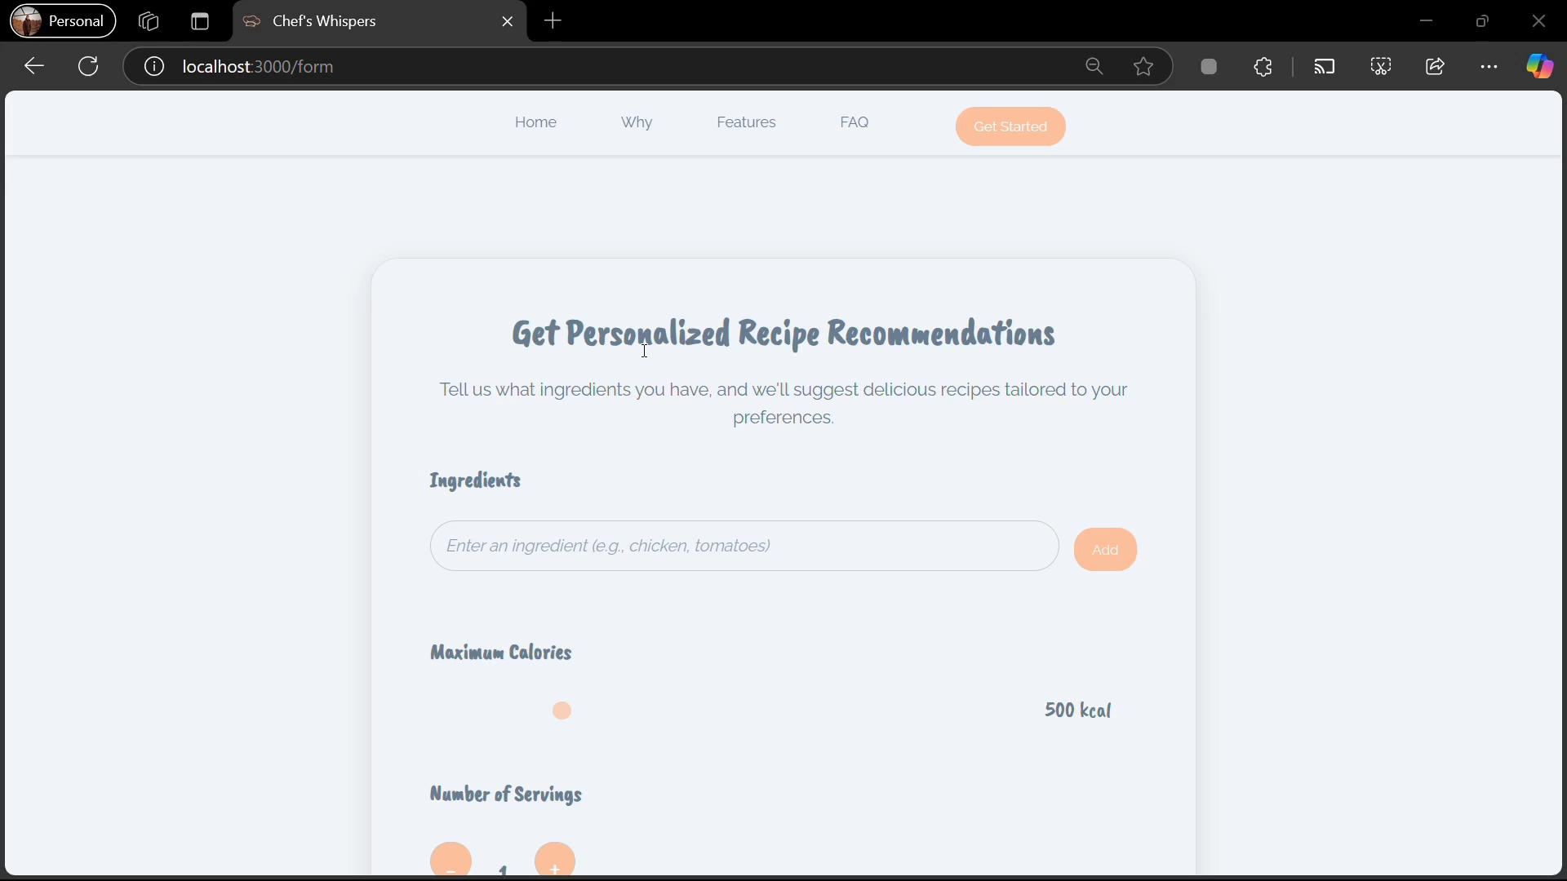
Demo
Notes:
Korrie
updated 7/21

Slide 9
Takeaways
What Should the Audience Stop/Start Doing?
Stop wasting time with meal planning or searching for generic recipes.
Start using a personalized, ingredient-based approach to meal planning for more efficient and sustainable cooking.
What Can Be Done Without You?
Users can still plan meals manually, but it takes much more time and effort. Our solution automates the process, saving them time and reducing waste.
How Can Your Solution Speed Up/ Simplify/ Make It Cheaper?
Our solution provides instant meal suggestions based on ingredients, reducing meal planning time and helping users make the most of what they already have.
By minimizing food waste, it helps save money in the long run and simplifies meal preparation.
Notes:
Korrie
updated 7/21

